Slide 1
What do the Wright Brothers, Rev. Martin Luther King, and Apple have in common?
Notes:
I would like to start off by asking a question. What do the Wright Brothers, Rev. Martin Luther King, and Apple computer have in common?

Slide 2
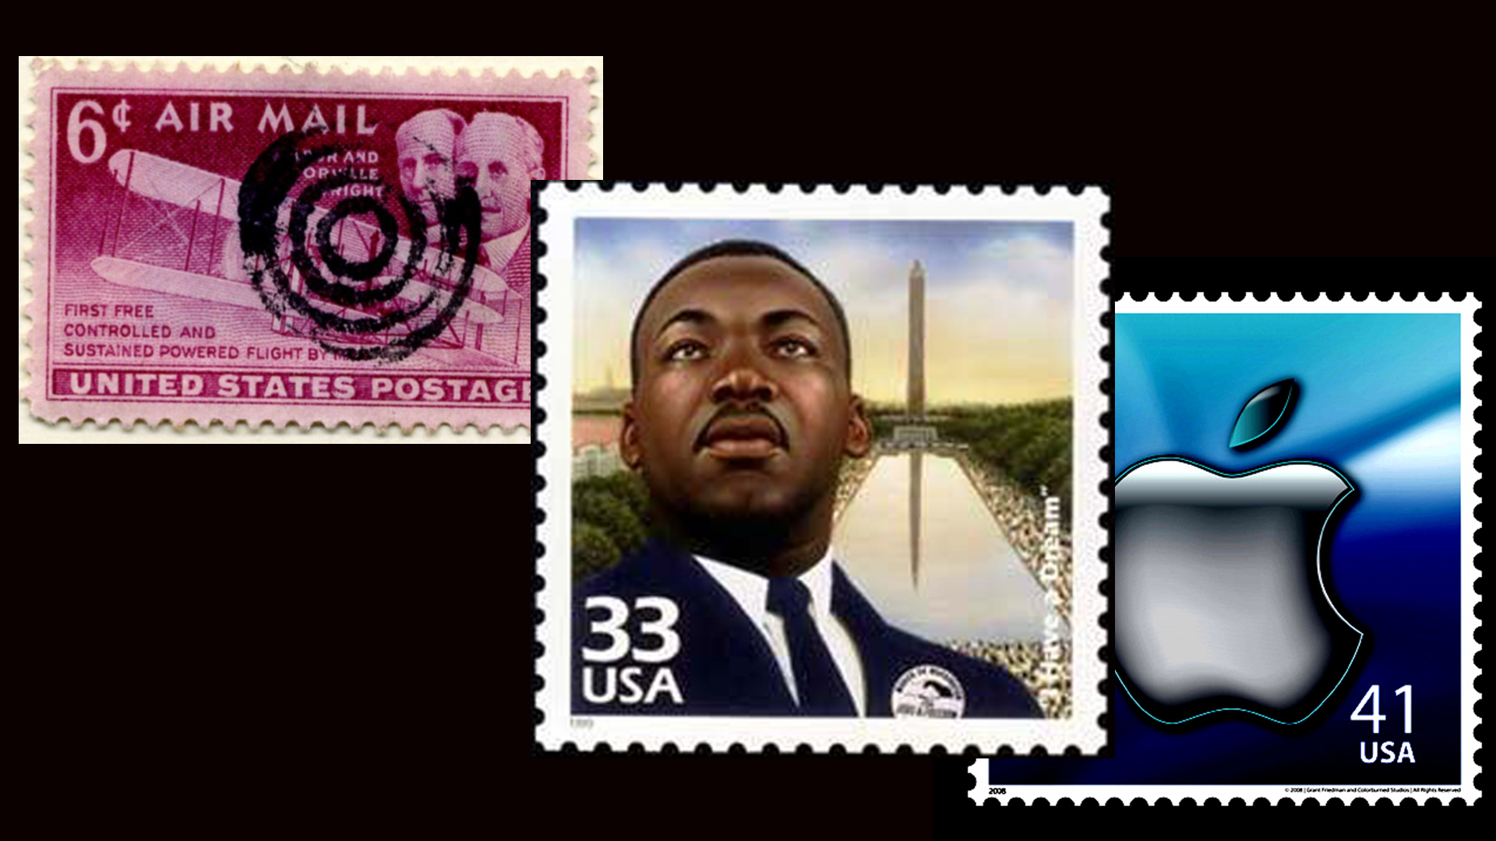
Notes:
How do you explain when others are able to achieve things that defy all assumptions.

Slide 3
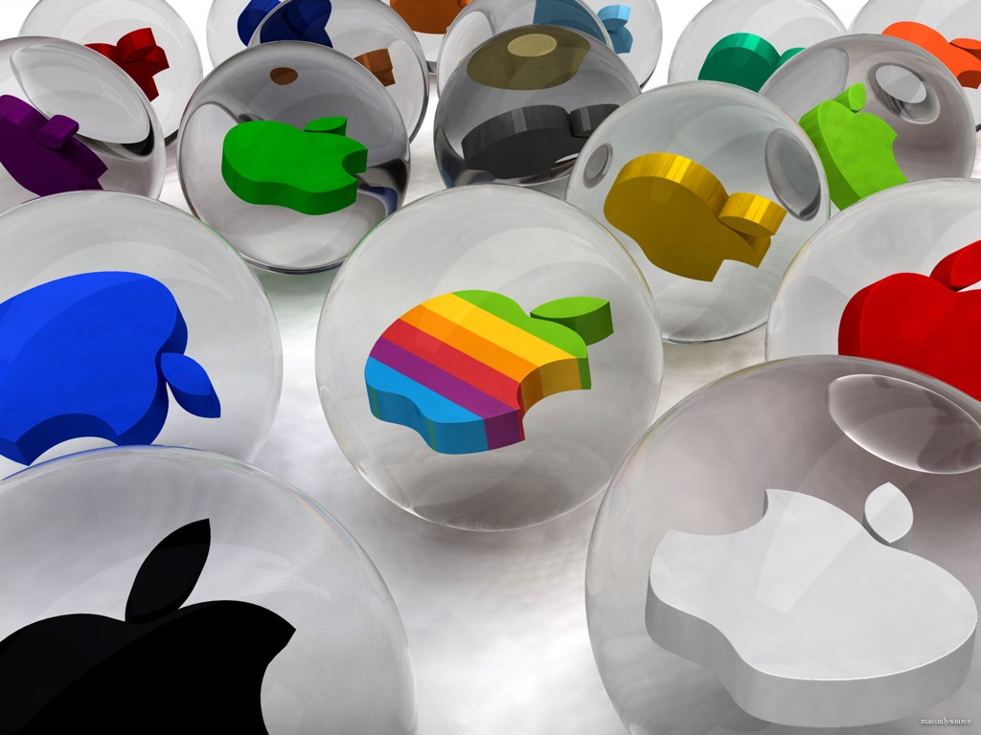
Notes:
For example why is Apple so innovative, year after year after year. Apple is more innovative then all of their competition.

Slide 4
Notes:
They’re just another computer company. Right? They have the same access to the same resources as every other company. Why do they have something different.

Slide 5
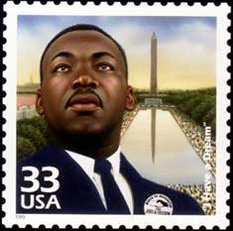
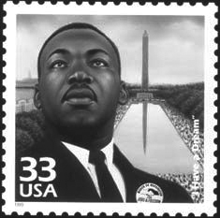
Notes:
Why was it that Martin Luther King led the civil rights movement? He wasn’t the only man that suffered in a pre-civil rights America and he certainly wasn’t the only great orator of his time.

Slide 6
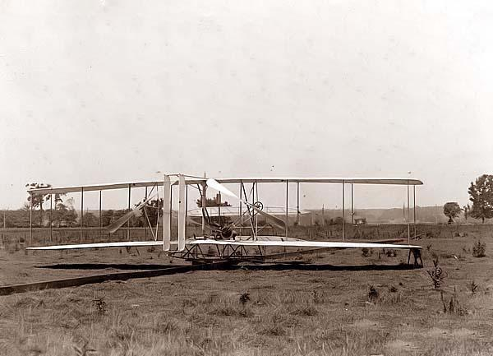
Notes:
Why is it the Wright brothers figured out man powered flight when there were certainly other teams out there who were better qualified, funded, and educated.

Slide 7
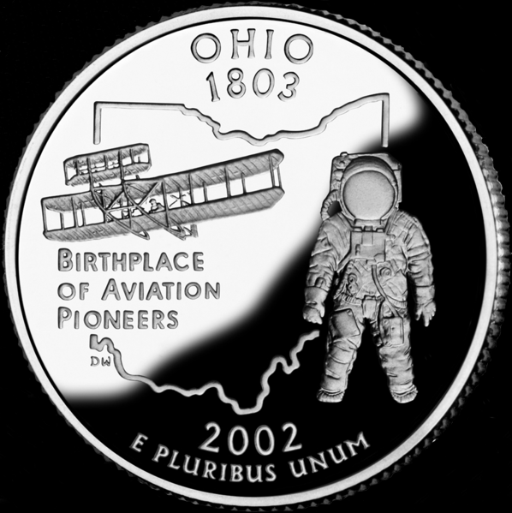
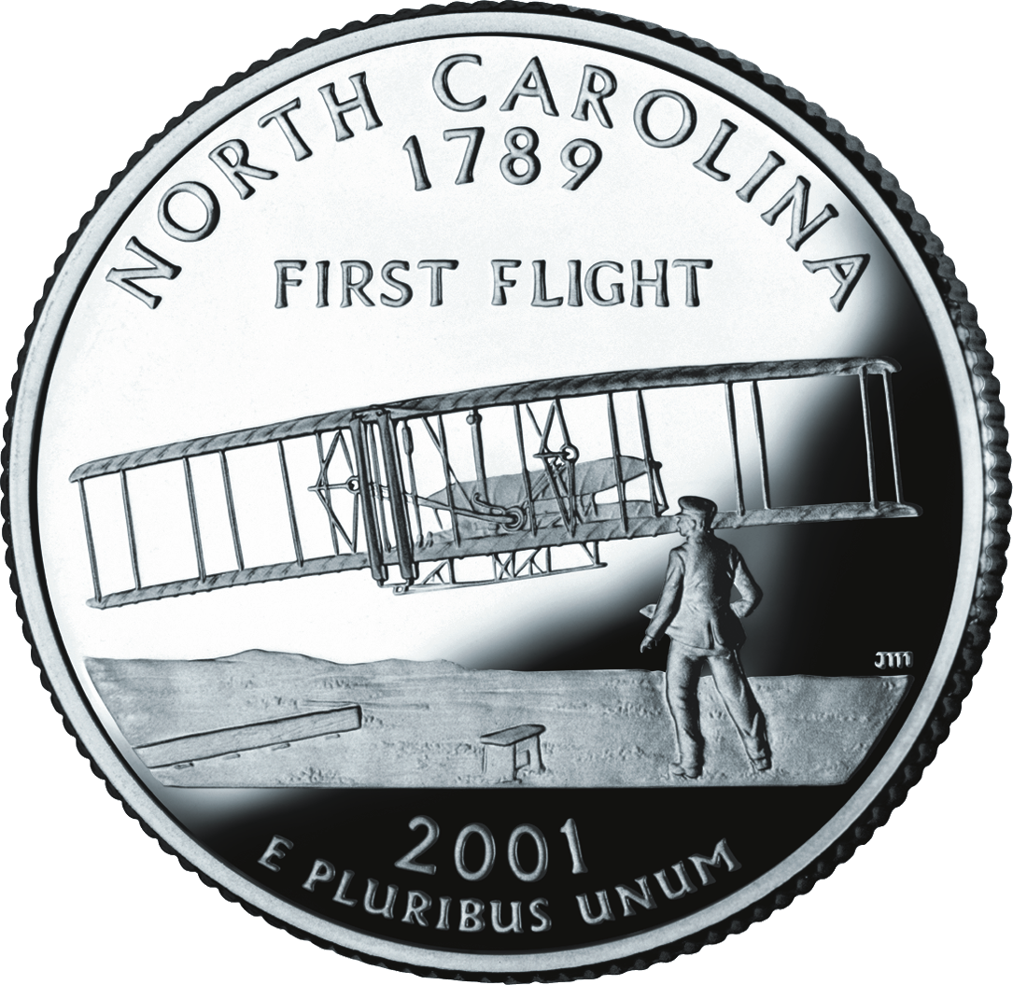
Notes:
There is a pattern going on here. As it turns out all the great and inspiring leaders and companies whether its Apple or Rev King or the Wright Brothers, well they all think, act, and communicate the same way and it’s the opposite of nearly everyone else. They are all storytellers.

Slide 8
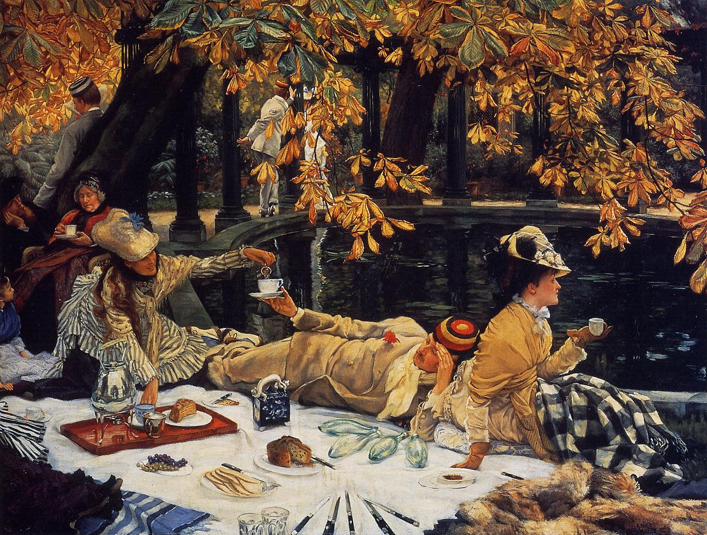
What, How, Why?
Notes:
Many people and organizations will tell you their “how” and their “what” they do, but they don’t know why.
Inspirational people know the “why.” They know “why” they do things. Why they exist, why they get out of bed in the morning and why should anyone care? The “why” is.. what’s your cause� what’s your belief..what’s your story? Inspired leaders and organizations think the same way.

Slide 9
Notes:
If Apple where like everyone else their commercials would sound like this: we make great computers, they’re beautifully designed and easy to use and user friendly. Want to buy one? Probably, not so much�

Slide 10
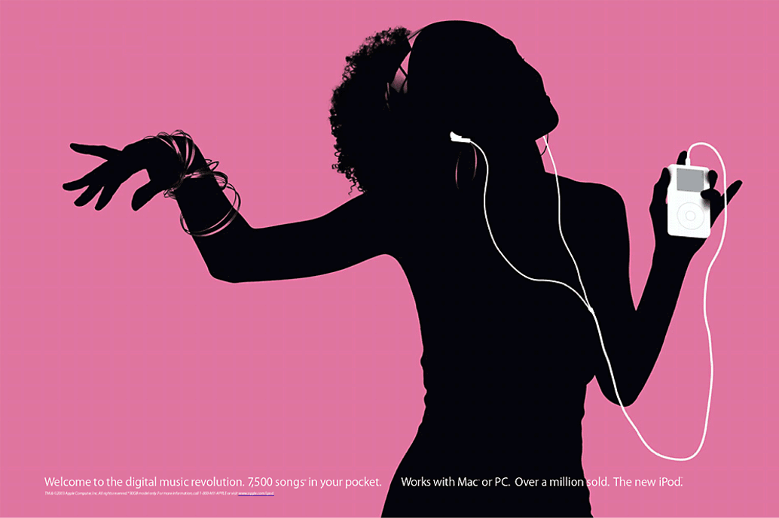
Notes:
But here is how Apple actually communicates. Everything we do.. we believe in challenging the status quo. We believe in thinking differently. The way we challenge the status quo is by making our products beautifully designed, easy to use and user friendly. We just happen to make great computers. Wanna buy one ? Totally different, right. People don’t buy and believe and follow the What.� People buy and believe and follow the Why.� In other words, people will buy and believe and follow your story, your passion.

Slide 11
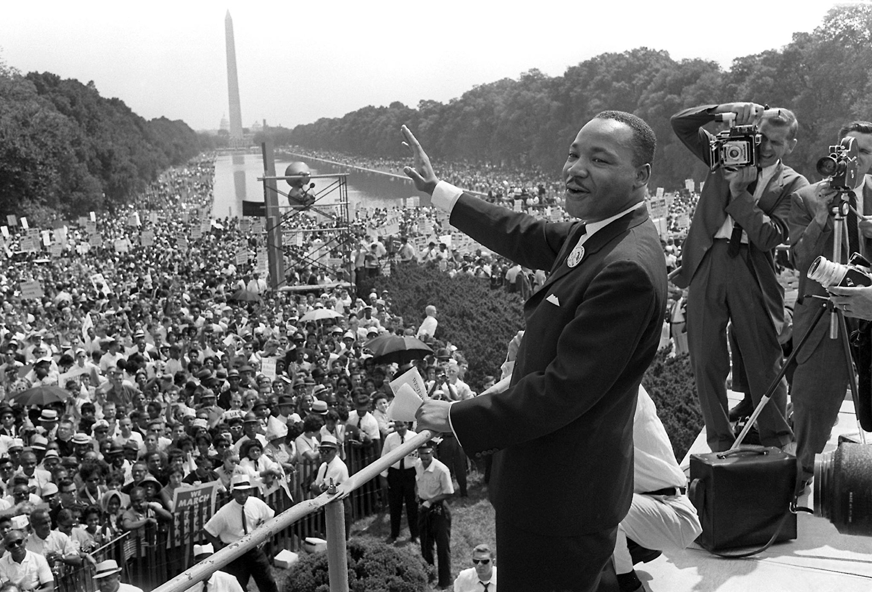
Notes:
In the summer of 1963 250,000 people showed up on the mall in Washington DC to hear Rev king speak. There were no invitations sent out. There was no website to check the date. Most of us here are old enough to remember a pre-web world.
Rev King wasn’t the only man in America who was a great orator or who suffered in a pre-civil rights America. In fact some of his ideas weren’t all that great. But he had a gift. He didn’t tell people what needed to be changed in America he told people what he believed. He told them a story. I believe. I believe.

Slide 12
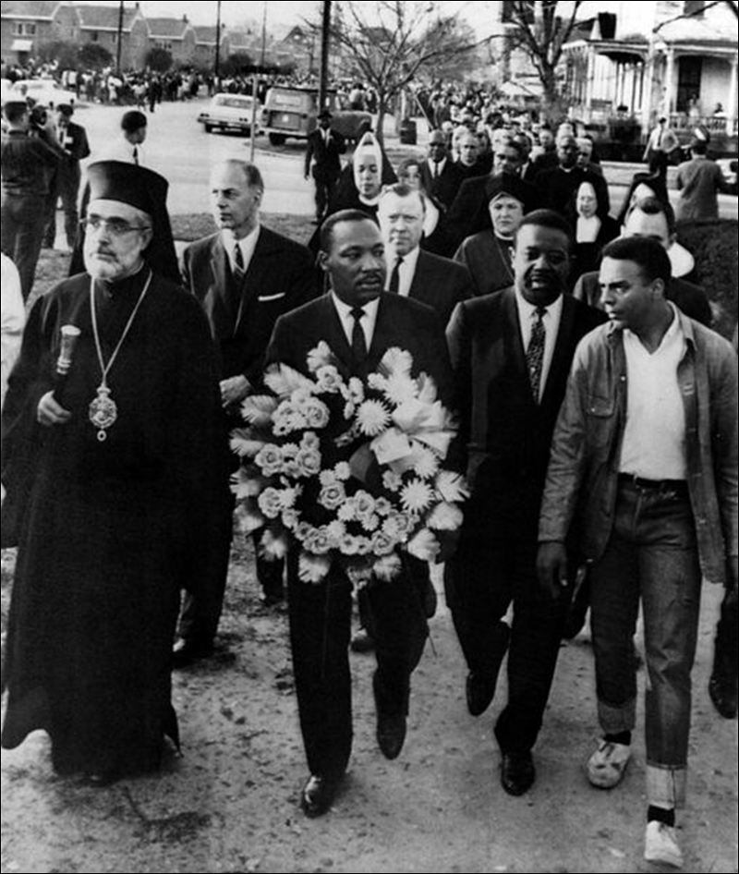
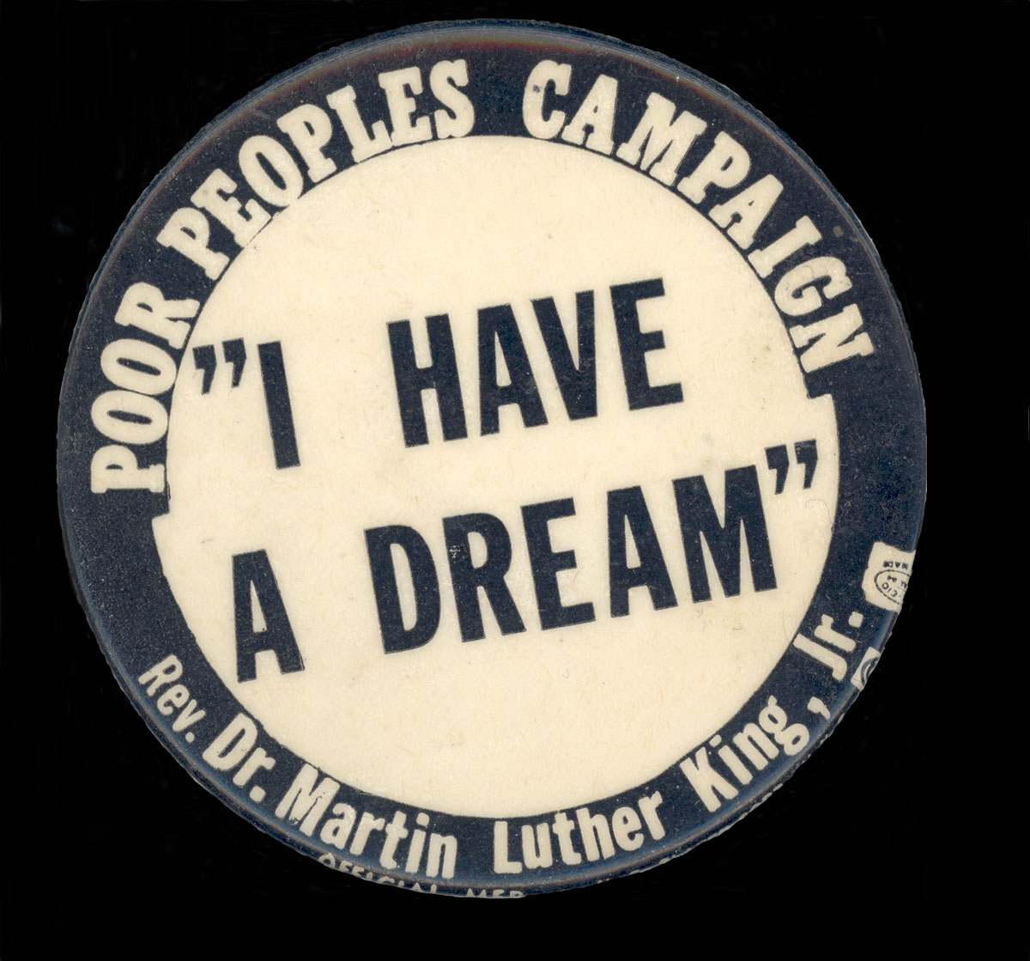
Notes:
I believe he told us. And people who believed what Rev King believed took his cause and made it their own. Then they told other people, and low and behold 250,000 people showed up on the right day at the right time to hear him speak. How many people showed up for him. None. They showed up for themselves. Why because its what they believed about America.

Slide 13
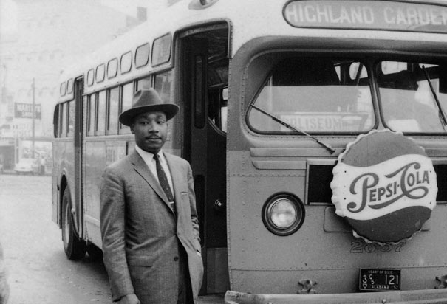
Notes:
It’s the narrative they wanted to hear which got them to travel in a bus for 8 hours to stand in the hot sun. He gave the I have Dream� speech not the 的 have a plan� speech. It’s those people who start with “why” that have the ability to inspire those around them.

Slide 14
Press play>
Notes:
Rev King in Montgomery – (Press Play for video)

Slide 15
Notes:
Samuel Pierpont Langley had the United States war department with all their funds and resources behind him. He had the scientists and faculty of Harvard University and the Smithsonian. But his only motivation was money. He knew the What and the how but had no clue as to the why.

Slide 16
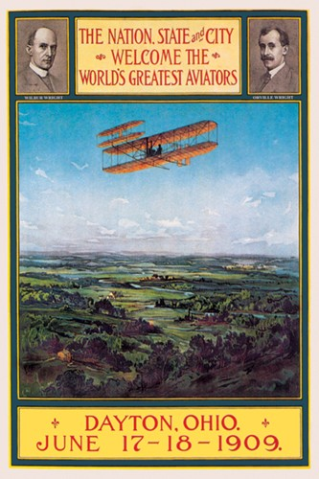
Notes:
In a small town in Dayton Ohio, two brothers with whatever money their bicycle shop could provide. Two brothers who literally came out of nowhere invented man powered flight.

Slide 17
Notes:
This is one of the bicycles they used to test wing designs on. A moving wind tunnel. What a crazy idea and yet it worked.

Slide 18
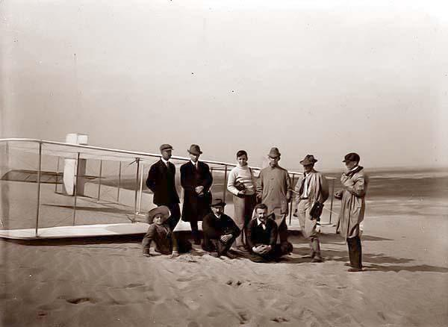
Notes:
And to top it all off not one person in the Wright Brothers team had a college education.
The Wright Brothers Team was driven by a cause, by a belief, by the inspired story that the Wright Brothers told.

Slide 19
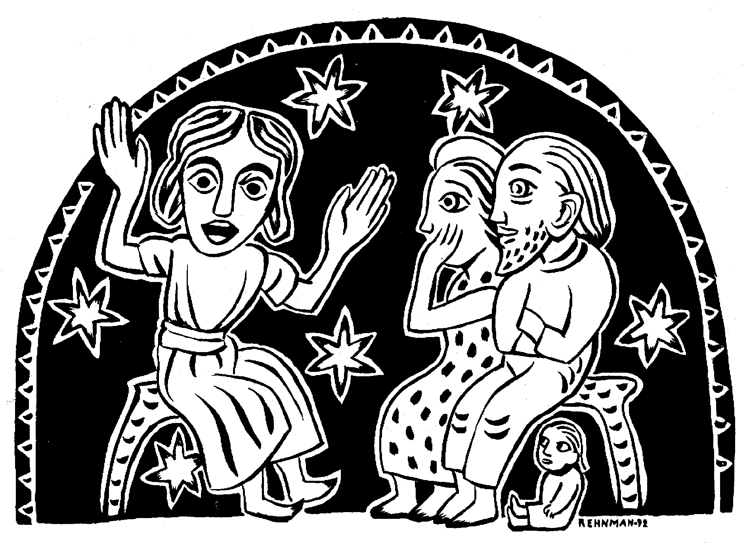
Notes:
Storytelling is one of the oldest, if not the oldest method of communicating ideas and images.

Slide 20
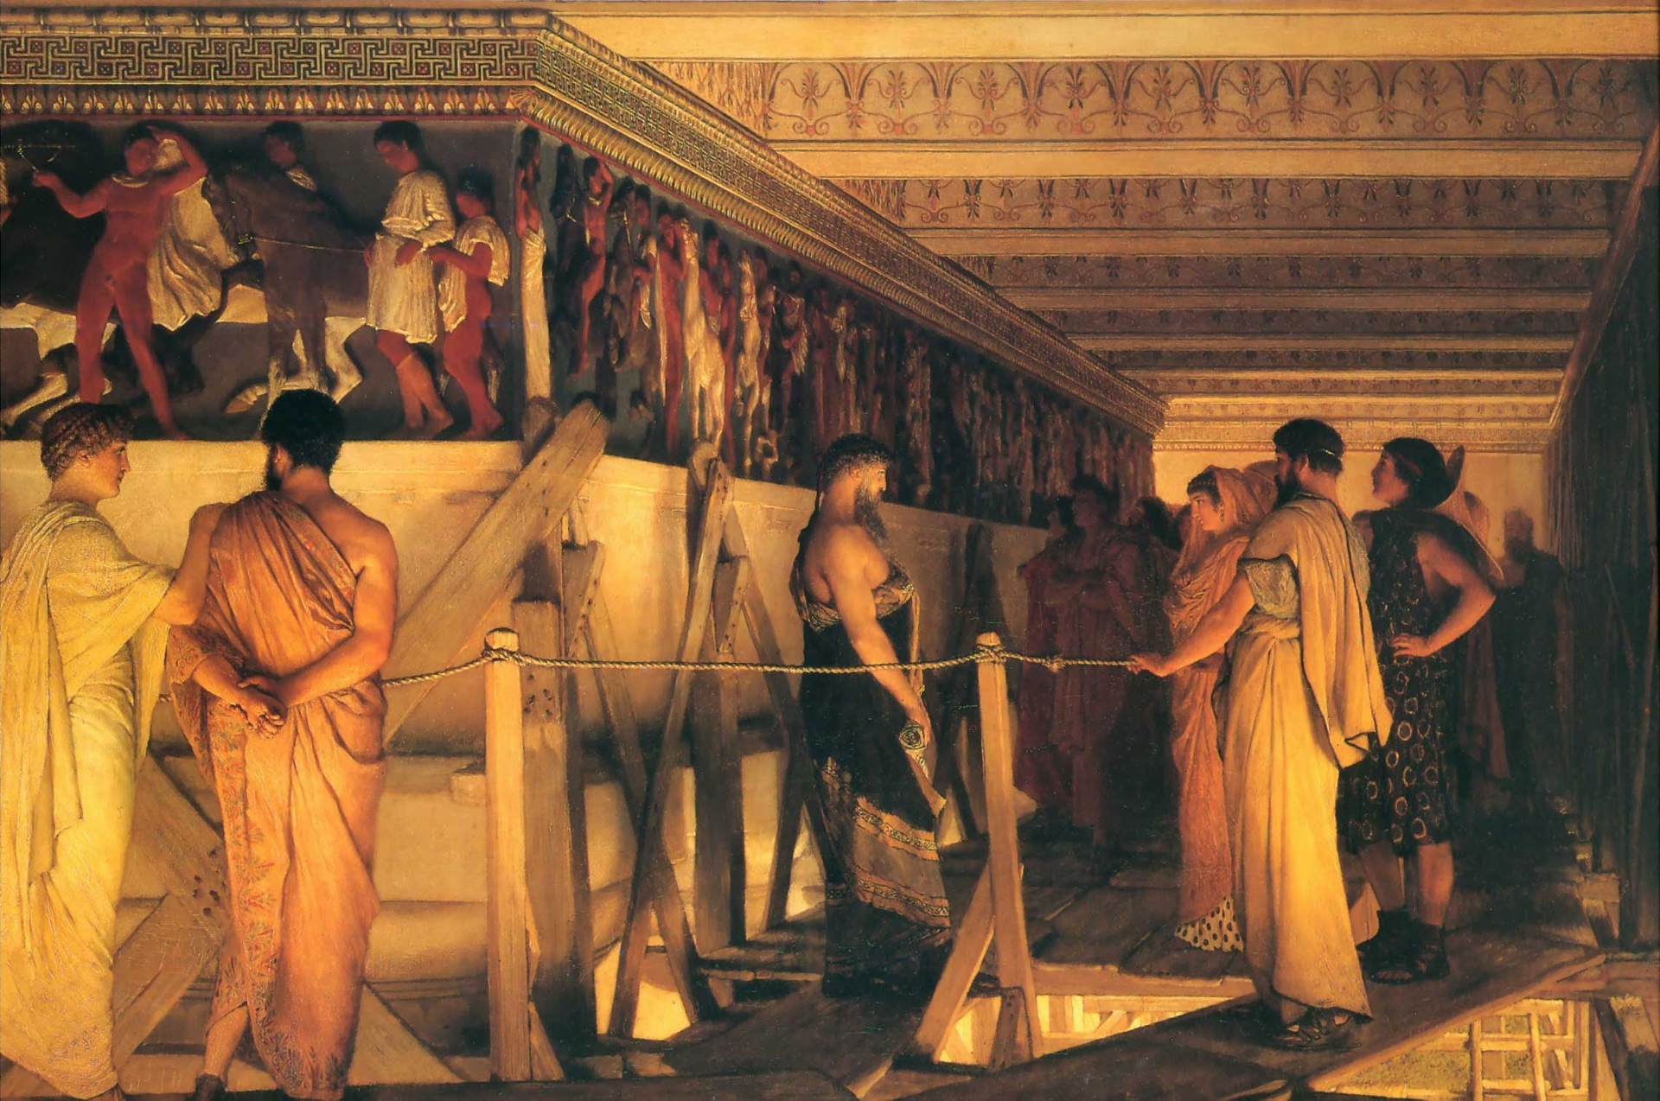
Notes:
Story performance honed our mythologies long before they were written and edited by scribes, poets, or scholars.

Slide 21
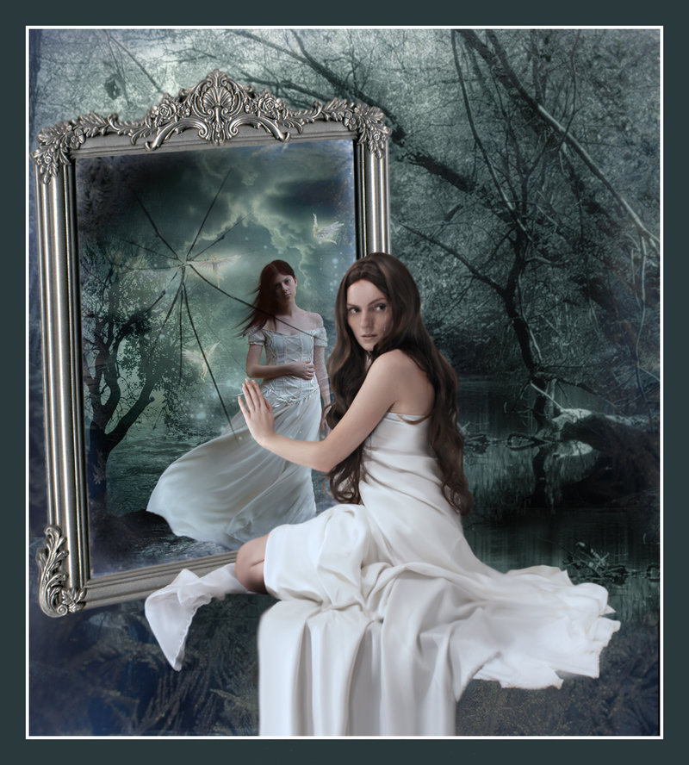
Storytelling is about:
Sharing knowledge & values
Developing trust & commitment
Sharing emotions
Notes:
Storytelling and Digital Storytelling is about
1.Sharing knowledge & values
2.Developing trust & commitment
3.Sharing emotions

Slide 22
Press play>
Notes:
My brother Constantine’s video – (Press Play for video)

Slide 23
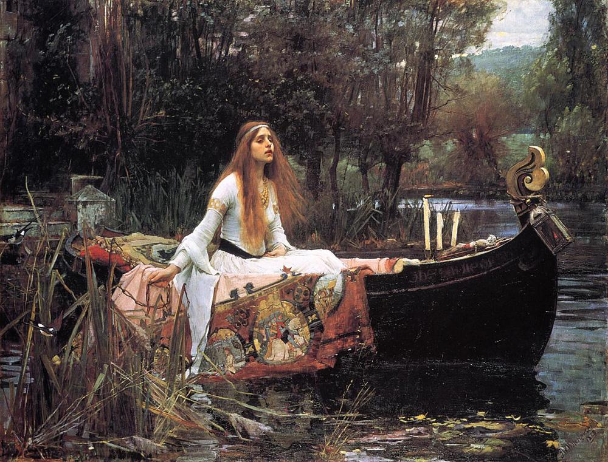
Notes:
Quick, think of a good story you’ve heard in the last few months, or even years – any story (short story, childhood bedtime story, a narrative joke, a
story in a presentation).

Slide 24
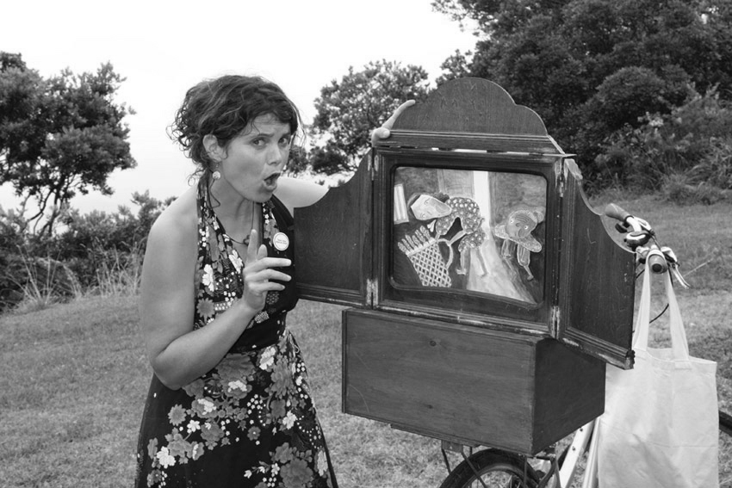
Notes:
Now think of a couple of good statistics you’ve heard in the last few weeks. Which one came easiest? Sorry to use a statistic as an illustration but nine times out of 10, it’s the story.

Slide 25
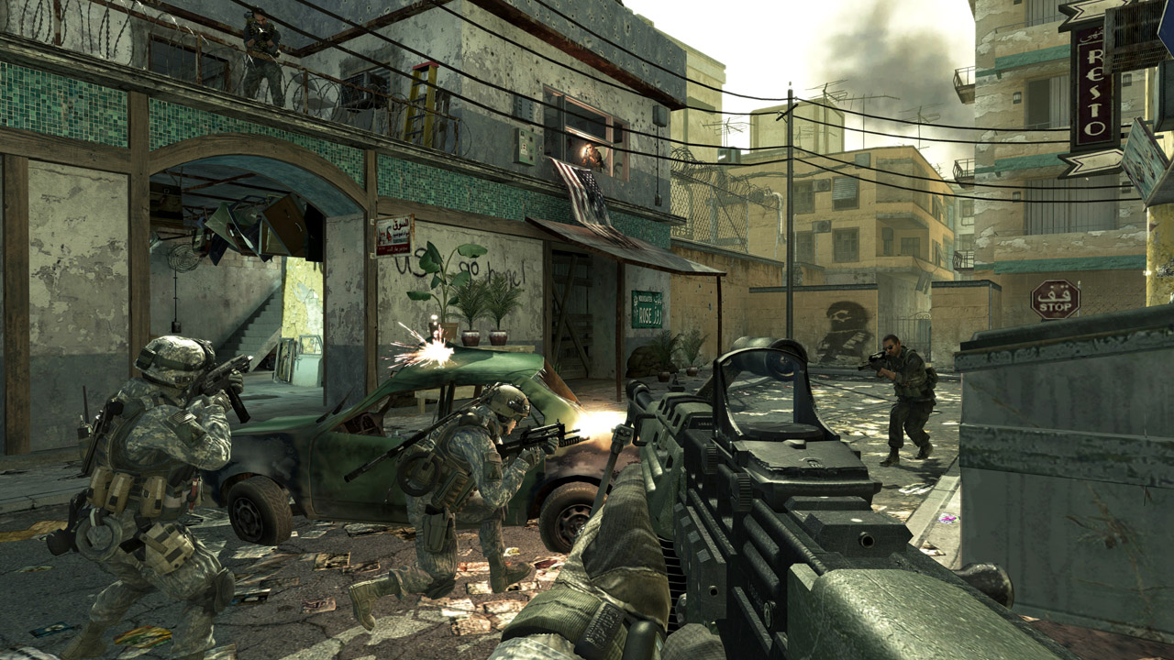
Notes:
Stories stick in our heads, sometimes for years. But not much attention is given to storytelling. Why is that? That’s weird since social media is the perfect storytelling venue.

Slide 26
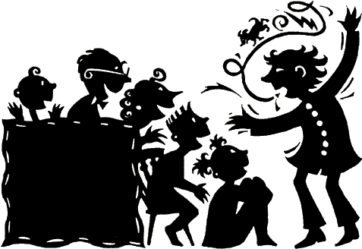
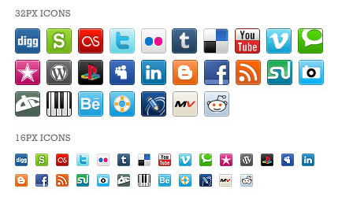
Notes:
Bloggers are our modern day storytellers. They’re not marketers, as many like to think, but humans with emotions, with their history and baggage – and specific views of the world. In other words, they are all walking stories, ready to be told.

Slide 27
Notes:
Stories are more powerful today than ever. Why, because we are drowning in information. Good stories can cut through the noise.

Slide 28
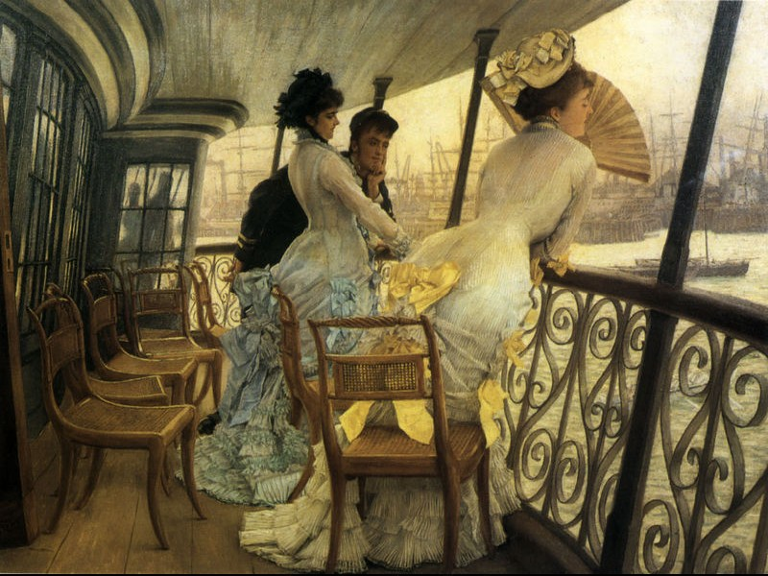
Notes:
Personal stories feel real� vs abstract concepts, statistics, or logical arguments

Slide 29
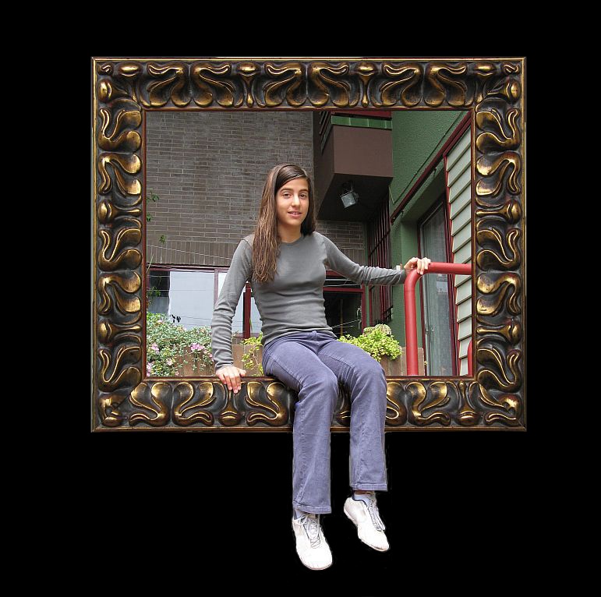
Notes:
Stories capture people on an emotional level, creating a deeper, intimate bond.
Stories are memorable.

Slide 30
Notes:
People forget facts but they remember stories.

Slide 31
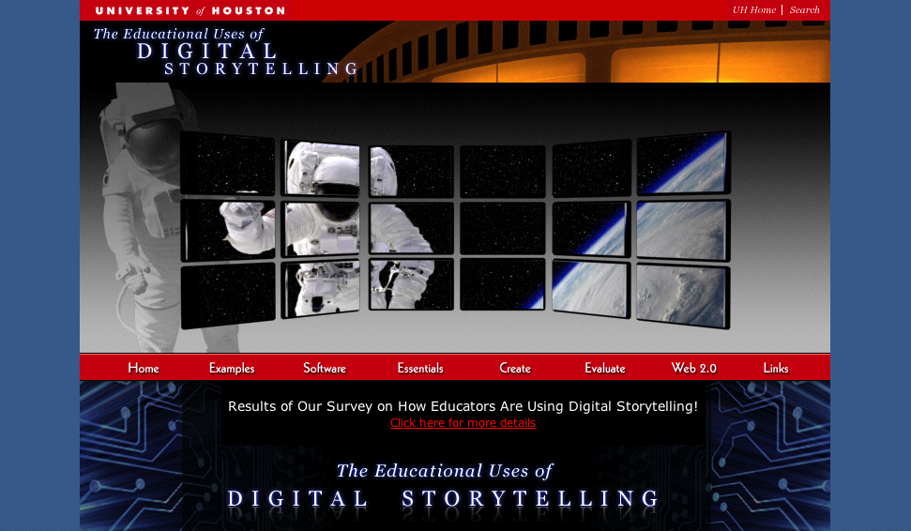
Notes:
The power of Digital Storytelling…

Slide 32
References
Copy of Corporate Storytelling: frame by frame by Raf Stevens on Prezi. (n.d.). Retrieved June 12, 2013, from http://prezi.com/jepjxogcwjfc/copy-of-corporate-storytelling-frame-by-frame/
Digital Stories @ UMBC. (2031). Retrieved June 13, from http://www.umbc.edu/blogs/digitalstories/2009/05/summer_digital_story_workshop.html
Educational Uses of Digital Storytelling. (n.d.). Retrieved June 12, 2013, from http://digitalstorytelling.coe.uh.edu/
How Long? Not Long!. (n.d.). Retrieved June 12, 2013, from http://www.youtube.com/watch?v=TAYITODNvlM&feature=related
Jay O’Callahan: The Power of Storytelling - 99U. (n.d.). Retrieved June 12, 2013, from http://the99percent.com/videos/6857/jay-ocallahan-the-power-of-storytelling
Sir Ken Robinson: Do schools kill creativity?. (n.d.). Retrieved June 11, 2013, from http://www.youtube.com/watch?v=iG9CE55wbtY
Sir Ken Robinson: Transform Education? Yes, We Must. (n.d.). Retrieved June 11, 2013, from http://www.huffingtonpost.com/sir-ken-robinson/transform-education-yes-w_b_157014.html
Retrieved June 11, 2013, from www.umbc.edu/oit/newmedia/studio/digitalstories/projects.php?movie=DSW09_constantine.flv

